Slide 1


A 28nm SoC with a 1.2GHz 568nJ/Prediction Sparse Deep-Neural Network Engine with >0.1 Timing Error Rate Tolerance for IoT Applications
Peizhuo Wang
2019.04.11

Slide 2
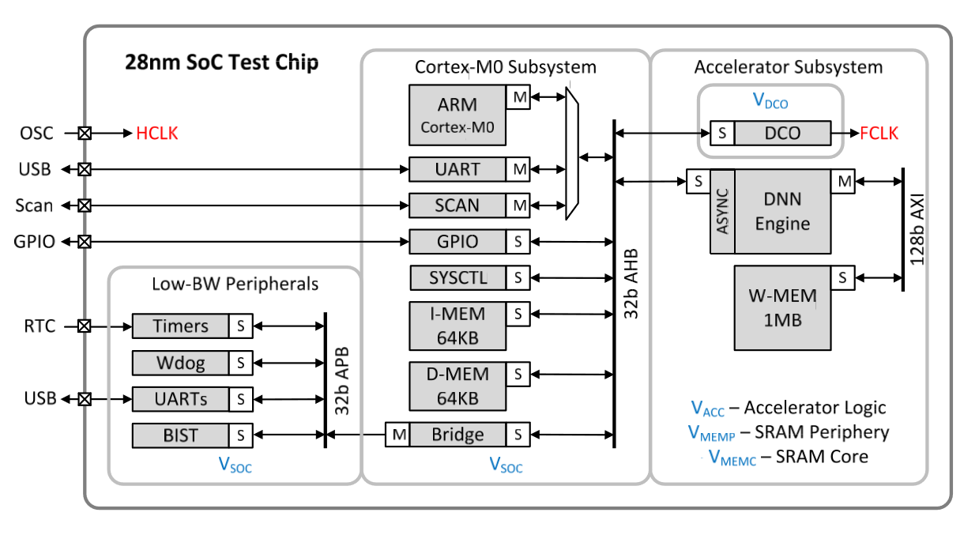
Overall Architecture

Slide 3
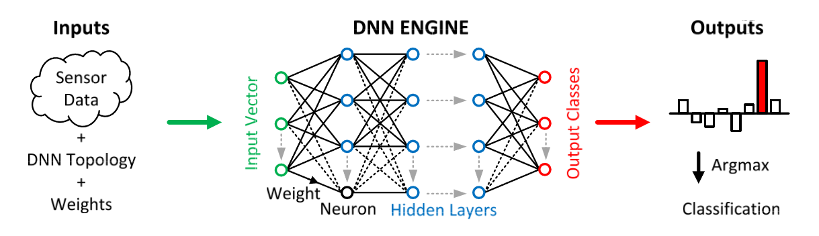
Motivation
-Parallelism：Balanced memory bandwidth and throughput
-Sparsity：HW support for sparse data and small datatypes
-Resilience：Razor adaptation to minimize PVT margins

Slide 4
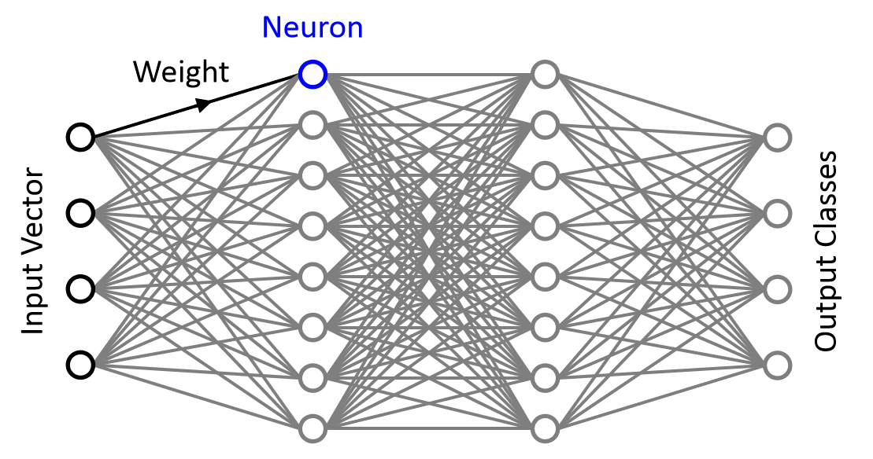
Fully-Connected DNN Graph

Slide 5
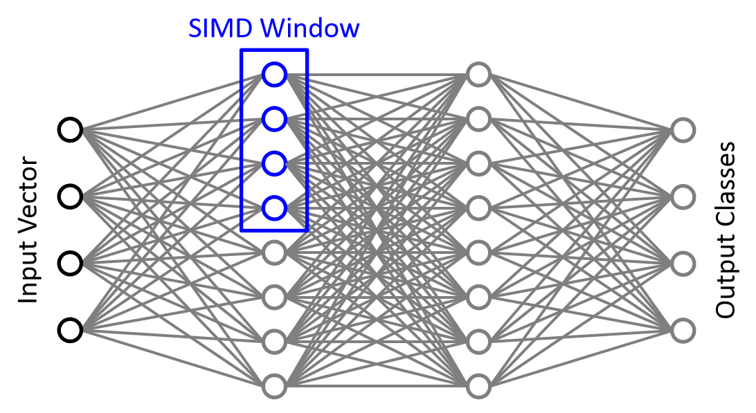
Fully-Connected DNN Graph

Slide 6
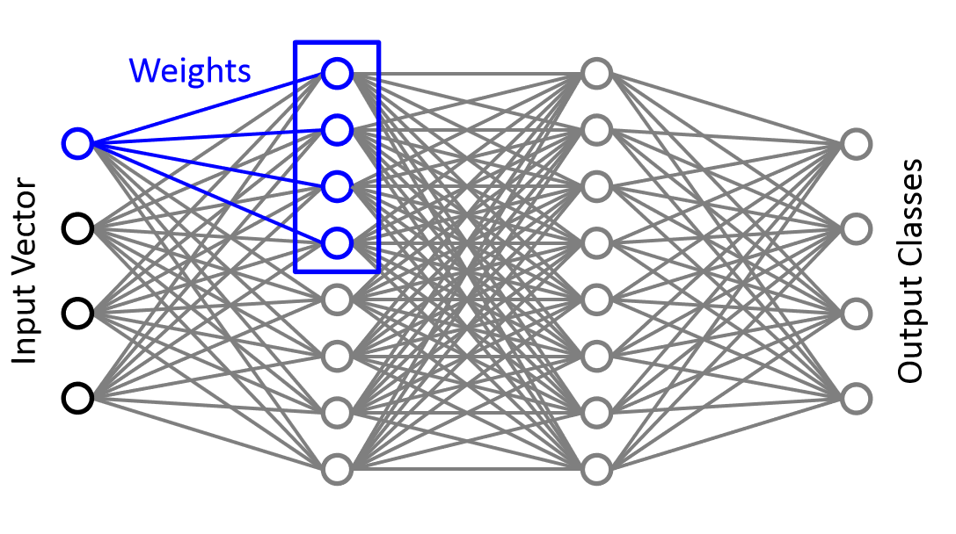
Fully-Connected DNN Graph

Slide 7
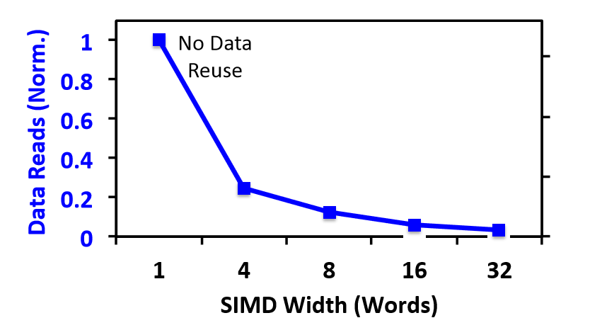
Balancing Efficieny and Bandwidth

Slide 8
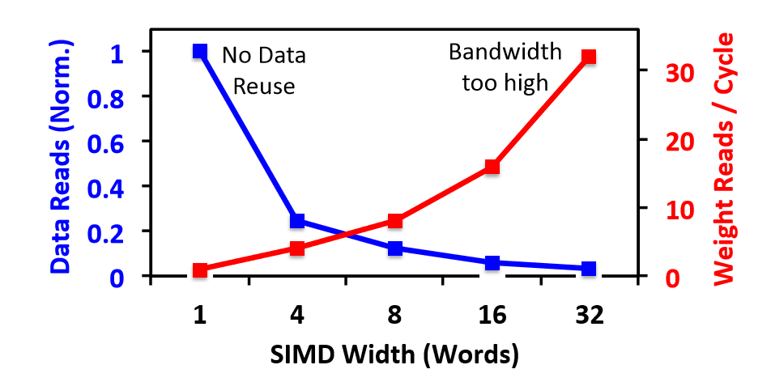
Balancing Efficieny and Bandwidth

Slide 9
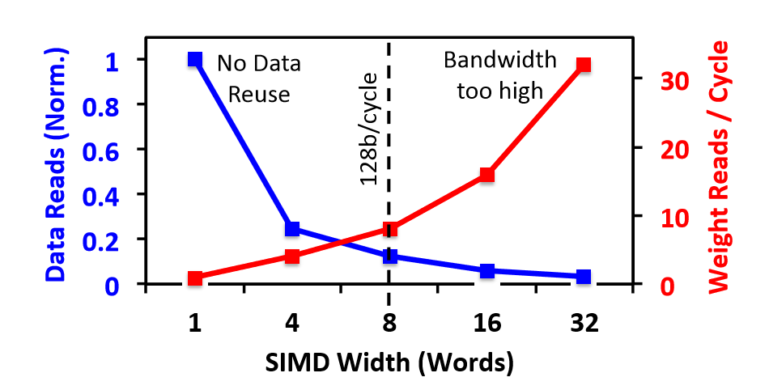
Balancing Efficieny and Bandwidth
8-Way SIMD is efficient at reasonable memory BW

Slide 10
Balancing Efficieny and Bandwidth
8-Way SIMD is efficient at reasonable memory BW

Slide 11
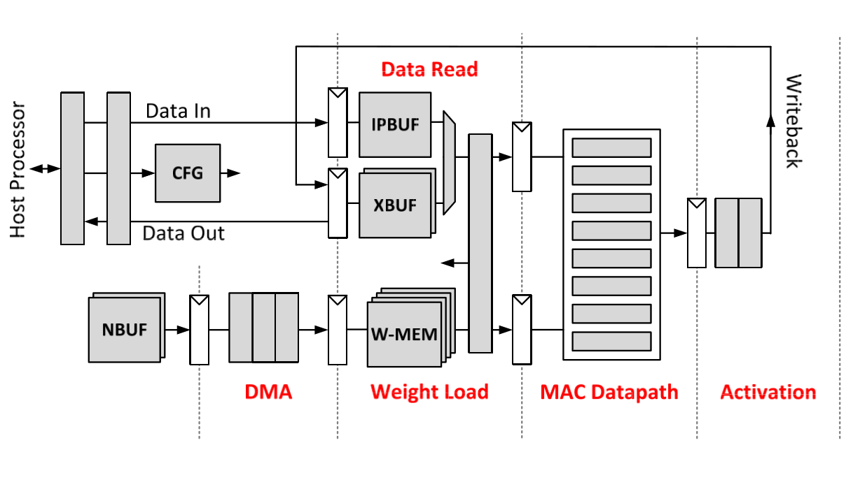
DNN ENGINE Micro-Architecture

Slide 12
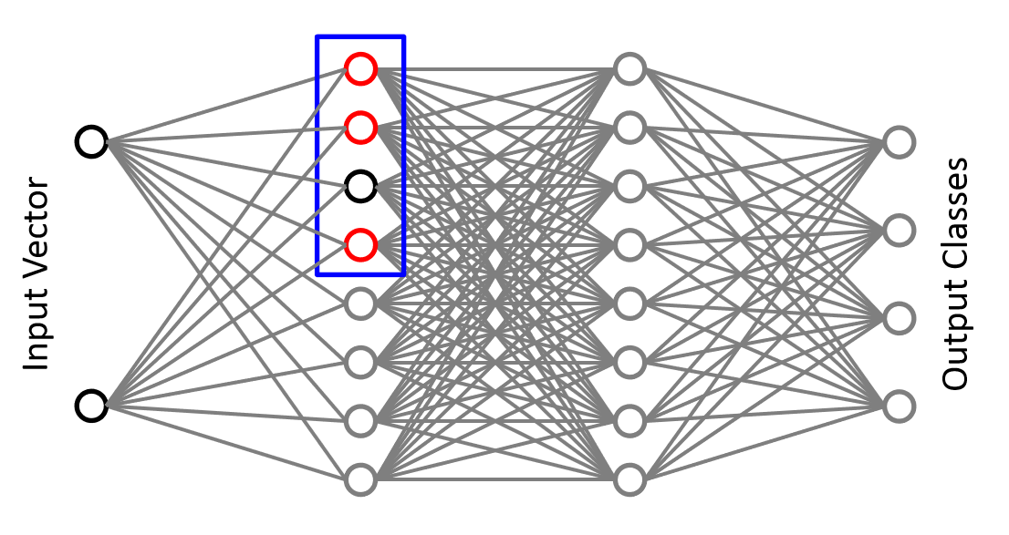
Exploiting Sparse Data in DNNs

Slide 13
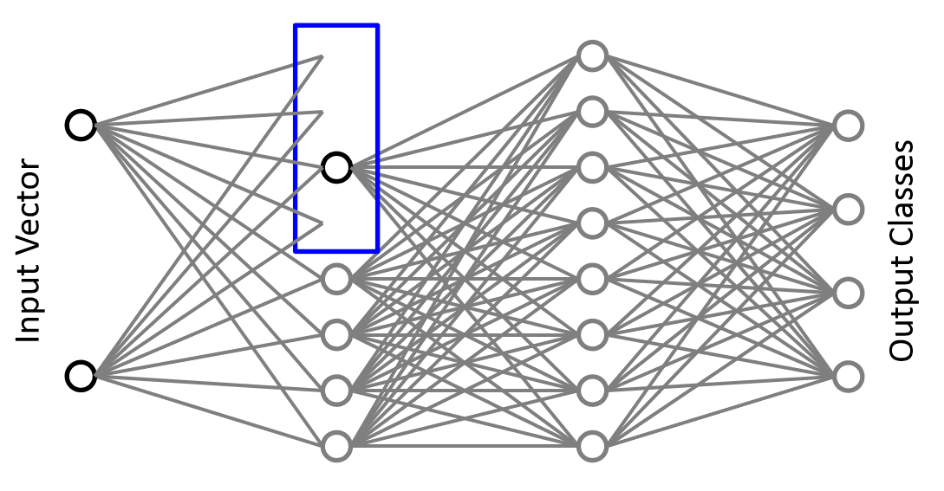
Exploiting Sparse Data in DNNs

Slide 14
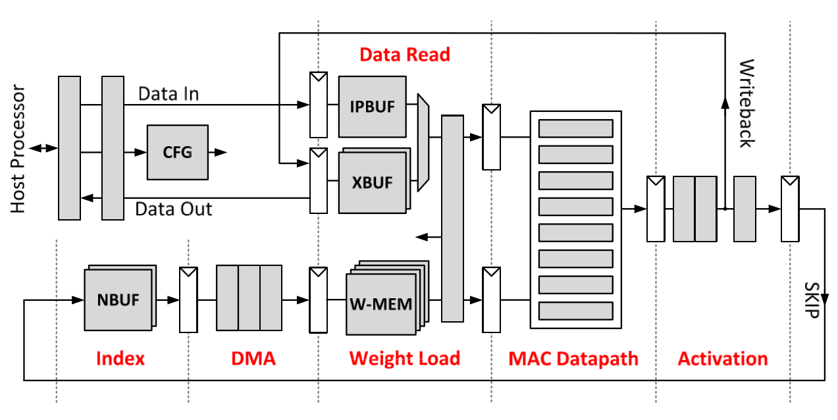
Exploiting Sparse Data in DNNs

Slide 15
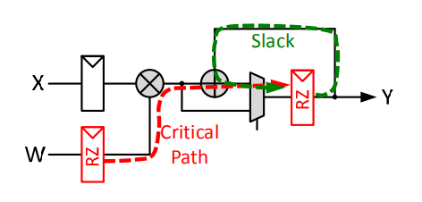
Resilience
Razor timing violation detection

